Slide 1

CS244
Advanced Topics in Networking
Lecture 10: Buffer Sizing
Nick McKeown
“Sizing Router Buffers” [Appenzeller, et al. 2004]
Spring 2020

Slide 2
Context
Guido Appenzeller
At the time: CS PhD student
Founded Big Switch Networks
CTO at VMware for networking
Sigcomm Test of Time Award, 2015
At the time of writing
Challenging to build ISP routers with big buffers
80% of world’s SRAMs used for router and switch buffers/counters
ISP routers sold with ~90% profit margin

Slide 3
Why should we care?
Background
No universal agreement on how big a router buffer should be
Or why.
Yet buffers are a major cause of variation in packet delay.
Big buffers require large, slow DRAM memories…
…which complicate the design of large routers.
It would be nice if we could use single chip switches and routers

Slide 4
Simple model of FCFS router buffer
1
C
C
C
C
N
B
Q: Why does the router have a buffer (or queue)?
Q: What factors determine the buffer’s size?
Notes:
Factors:
Long-term congestion. (a) TCP-like flows, (b) Incast
Short-term burstiness. (a) random fluctuations, (b) Burstiness of a flow.
Memory technology. SRAM, DRAM, on-chip, off-chip. Speed and size.

Slide 5
Simple model of a router
B
C
1
1
C
N
N

Slide 6
Simple Internet queueing model

Slide 7
Early Internet Models
Leonard Kleinrock
Professor at UCLA
1963: 1st theoretical study of packet switching using queueing theory
1969: 1st message sent over Internet.
UCLA IMP (Interface Message Processor)

Slide 8
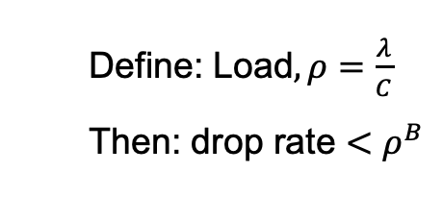
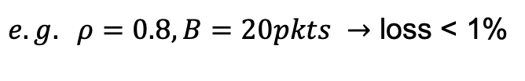
Example model of single packet queue
Poisson Traffic, fixed size packets
M/D/1
Poisson arrivals, rate λ
C
B
Define: Load$, ρ=\frac{λ}{C}$
Then: drop rate $<ρ^{B}$
$e.g. ρ=0.8, B=20pkts →$ loss < 1%
Observations:
Packet drop rate is small
Independent of C, RTT, number of flows, etc.
Notes:
Poisson arrivals means “memoryless process”, exponentially distributed interarrival times. Conditionally unioform. Most benign type of arrival.
Tantalizing result; remember for later. This model can be composed to create networks of switches that can be analyzed. (Kleinrock)

Slide 9
Q: How well does this model fit today’s Internet?
The model assumes traffic is generated “open loop” by the source.
Today’s Internet carries mostly TCP traffic, which uses a closed loop congestion control algorithm.
Notes:
TCP is closed loop. Flow behavior determined by congestion control loop.

Slide 10

With multiple flows, RTT is less variable
Router buffer
A
Link rate > C
Link rate = C
B
Observations:
An arriving packet sees a usually-full queue
RTT is pretty much constant (very different from single flow case)
Drops are random events

Slide 11
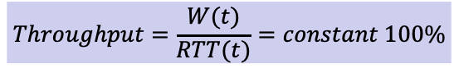
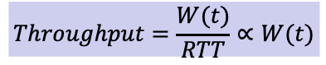
One flow vs multiple flows
One flow
$$Throughput=\frac{W(t)}{RTT(t)}=constant 100\%$$
cwnd
Buffer occupancy and RTT
t
Multiple flows
$$Throughput=\frac{W(t)}{RTT}∝W(t)$$
Buffer occupancy and RTT
Buffer
Occupancy
and RTT
t
(Zoom in)
cwnd
One of the flows
t

Slide 12
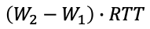
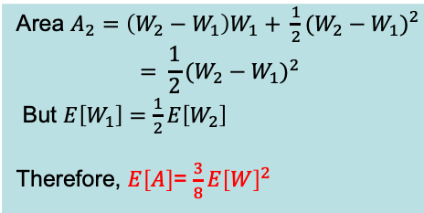
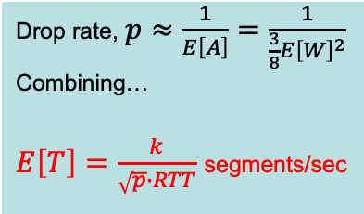
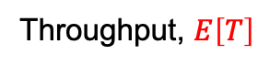
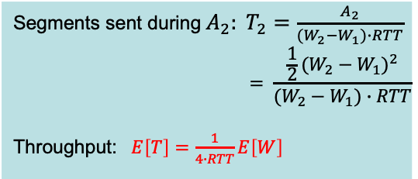
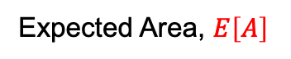
Geometric intuition for throughput equation
Drop
cwnd
W₂
A₃
A₂
A₁
1
Note: To convert from packets/second to bits/second, multiply throughput by the packet size (e.g. MSS)
W₁
RTT
?
t
$$\left(W_{2}−W_{1}\right)∙RTT$$
Expected Area, $E\left[A\right]$
Throughput, $E\left[T\right]$
Combining
Area $A_{2}=\left(W_{2}−W_{1}\right)W_{1}+ {\frac{1}{2}(W_{2}−W_{1})}^{2}$
$$= {\frac{1}{2}(W_{2}−W_{1})}^{2}$$
But $E\left[W_{1}\right]=\frac{1}{2}E\left[W_{2}\right]$
Therefore, $E\left[A\right]$= $\frac{3}{8}{E\left[W\right]}^{2}$
Segments sent during${ A}_{2}: T_{2}=\frac{A_{2}}{(W_{2}−W_{1})∙RTT}$
$$= \frac{{\frac{1}{2}(W_{2}−W_{1})}^{2}}{(W_{2}−W_{1})∙RTT}$$
Throughput: $E\left[T\right]=\frac{1}{4∙RTT}E\left[W\right]$
Drop rate, $p≈\frac{1}{E\left[A\right]}=\frac{1}{\frac{3}{8}{E\left[W\right]}^{2}}$
Combining…
$E\left[T\right]=\frac{k}{\sqrt{p}∙RTT}$ segments/sec
Notes:
“width” of A is W/2, so area is (3/8)*W^2

Slide 13
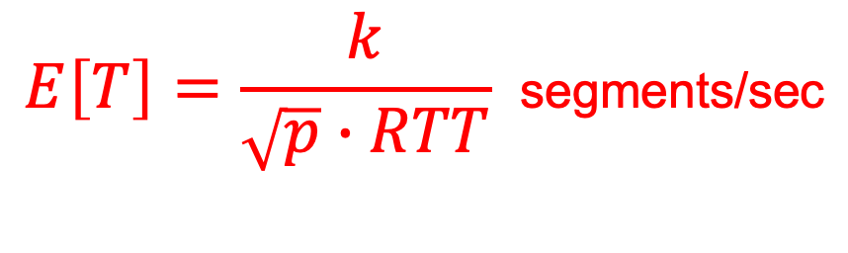
Interpreting the throughput equation
$$E\left[T\right]=\frac{k}{\sqrt{p}∙RTT} \text{segments}\text{/}\text{sec}$$
If RTT doubles, throughput halves.
If packet drop rate increases from 1% to 4%, throughput halves.
Notes:
Long RTT flows are penalized: If we double the RTT we can expect the rate to halve! This is clearly not a good property and is often identified as a weakness of the AIMD approach.
Similarly, the rate is very sensitive to the
R1/R2 = sqrt( p2/p1 ). i.e. if p2 = 4%, p1 = 1%, then the rate is HALVED.

Slide 14
One reason to care about buffer size
With on-chip buffers we can build
higher capacity switch ASICs

Slide 15
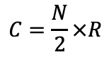
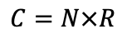
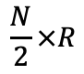
Switch Chips are Limited by Serial I/O Capacity to the outside world
Single chip switch ASIC
Small on-chip buffering
e.g. 64 Mbytes
Switch ASIC with external memory
Large off-chip buffering
e.g. 8 Gbytes
$$\frac{N}{2}×R$$
Switch ASIC #1
I/O Capacity: C
Switch ASIC #2
I/O Capacity: C/2
DRAM
1
2
3
N
.
.
.
.
.
.
.
.
.
.
.
1
2
3
N/2
.
.
.
.
R
R
$$C=N×R$$
$$C=\frac{N}{2}×R$$
e.g. 12.8 Tb/s = 128 x 100Gb/s

Slide 16
Switch Chips are Limited by Serial I/O Capacity
I/O Capacity: C
I/O Capacity: C/2
DRAM
DRAM
C
C/2

Slide 17
C
How many switch chips with capacity C/2 do we need to make a router with capacity C?

Slide 18
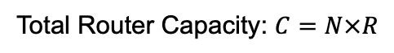
We need 6 ASICs with capacity C/2
I/O Capacity: C/2
DRAM
I/O Capacity: C/2
DRAM
C/8
C/8
C/8
C/8
I/O Capacity:C/2
DRAM
I/O Capacity: C/2
DRAM
I/O Capacity: C/2
DRAM
I/O Capacity: C/2
DRAM
C/4
C/4
C/4
C/4
Total Router Capacity: $C=N×R$

Slide 19
It is worth understanding where and when small on-chip buffers suffice

Slide 20
A brief history of buffer size

Slide 21
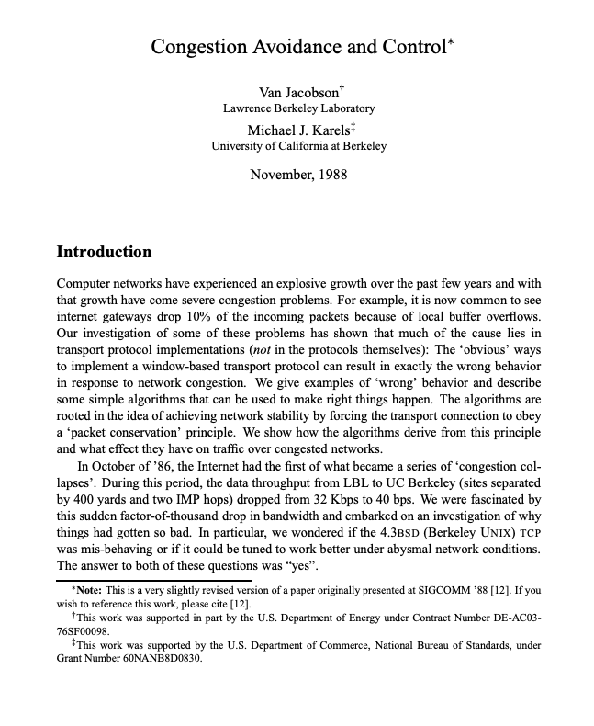
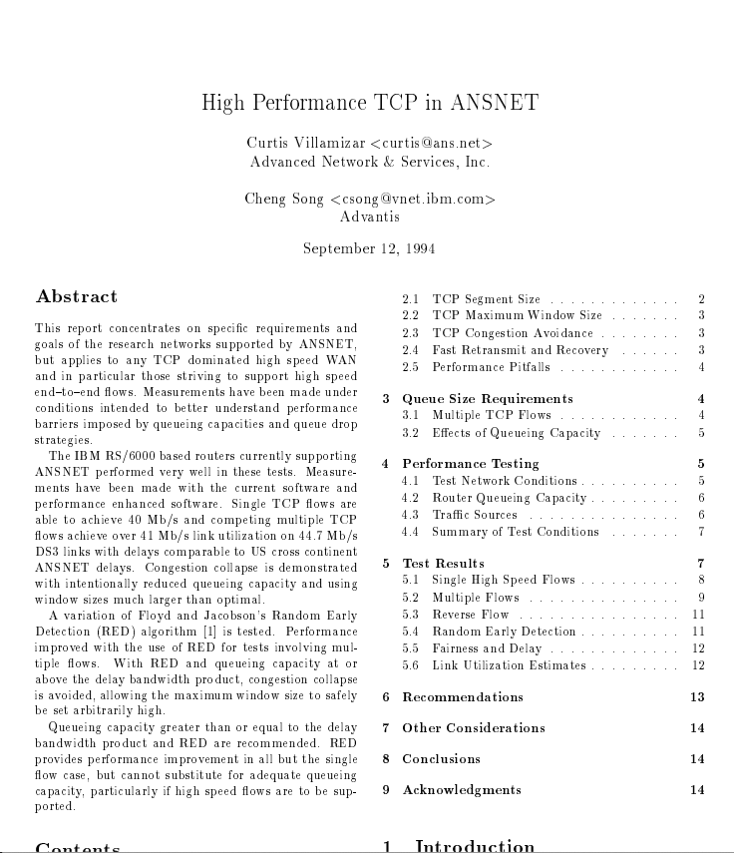
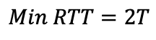
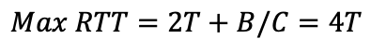
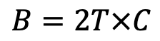
1988
1994
2019
Congestion Avoidance
and Control
VJ & MK
High Performance
TCP in ANSNET
CV & CS
$$B=2T×C$$
“Buffer size should equal the bandwidth delay product”
$$Max RTT=2T+B/C=4T$$
B
A
C
B
$$Min RTT=2T$$
Notes:
In their landmark paper in 1988, Van Jacobson and Mike Karels described how AIMD and slow start had been added to TCP for congestion control, based on the AIMD proposal from Raj Jain’s technical report the year before.
In 1994, Curtis Villamizar and Cheng Song reported their work to make TCP work well in ANSNET, with and without RED. One of their conclusions is that you need a buffer size of 2T * C or the BDP to maintain 100% utilization of the bottleneck. This result became widely cited and became widely assumed to be correct. And many router manufacturers still quote this result to say that you need a BDP of buffering in a router.
This has the worrying effect of doubling the RTT if the bottleneck is congested; and even more so if all the routers along the path have a full BDP of buffer and are congested.
Before we get stuck into the details, and try to understand how big the buffer should be in different situations, I thought it would be useful to revisit where this result comes from. Why is it widely assumed we need a BDP of buffering in a router?
As I will explain, it’s a somewhat arbitrary artifact of the decision to divide the window size by 2 upon a packet loss. Let’s see why….

Slide 22

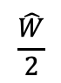
cwnd
B
A
C
B
time
2T
cwnd
$$\hat{W}$$
$$\frac{\hat{W}}{2}$$
t
time
Notes:
In the top right we have a simple network with one bottleneck link, carrying a single TCP flow.
Let’s see what buffer size we need, in order to keep the bottleneck link busy 100% of the time.
The graph shows a single sawtooth of the congestion window, varying from its max W-hat and halving each time a packet is dropped.

Slide 23
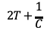
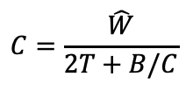
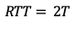
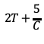
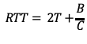
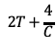

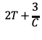
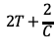
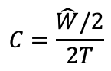
cwnd
2
B
A
C
B
1
time
2T
cwnd
$$C=\frac{\hat{W}}{2T+B/C}$$
2
$$\hat{W}$$
1
$$RTT= 2T+\frac{B}{C}$$
1
$$2T+\frac{5}{C}$$
1
$$2T+\frac{4}{C}$$
1
$$2T+\frac{3}{C}$$
1
$$2T+\frac{2}{C}$$
$$\frac{\hat{W}}{2}$$
1
$$2T+\frac{1}{C}$$
$$RTT= 2T$$
$$C=\frac{\hat{W}/2}{2T}$$
1
$$∴B=2T×C$$
t
time
Notes:
At the bottom of the sawtooth, the buffer just hits empty and, round trip time is at its minimum, which we call 2T. Each time a full window of packets is acknowledged, the window is incremented by one. Each time, the RTT also increases by one packet, because the queue always has one more packet in it. Until we reach the maximum window size. At this point, the buffer is full and the RTT equals 2T + B/C, the time for a packet to go through the buffer B/C plus the min RTT.
Notice that the link is full all the time all along the sawtooth from the bottom to the top, so we know the throughput is C all the time and the bottleneck link never goes idle.
In the next RTT a packet is dropped and TCP halves cwnd. At this point, the buffer drains and the RTT is back to the minimum RTT again. But the bottleneck link never goes empty.
By equating the capacity at (1) and (2) we easily conclude that B = 2T * C or the BDP.

Slide 24
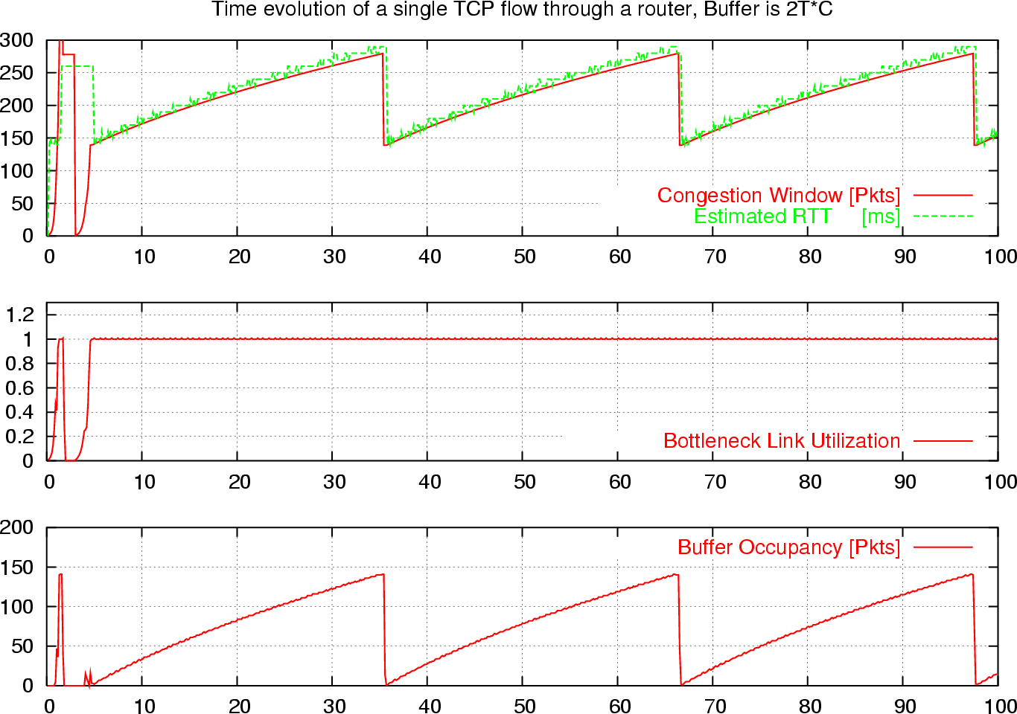
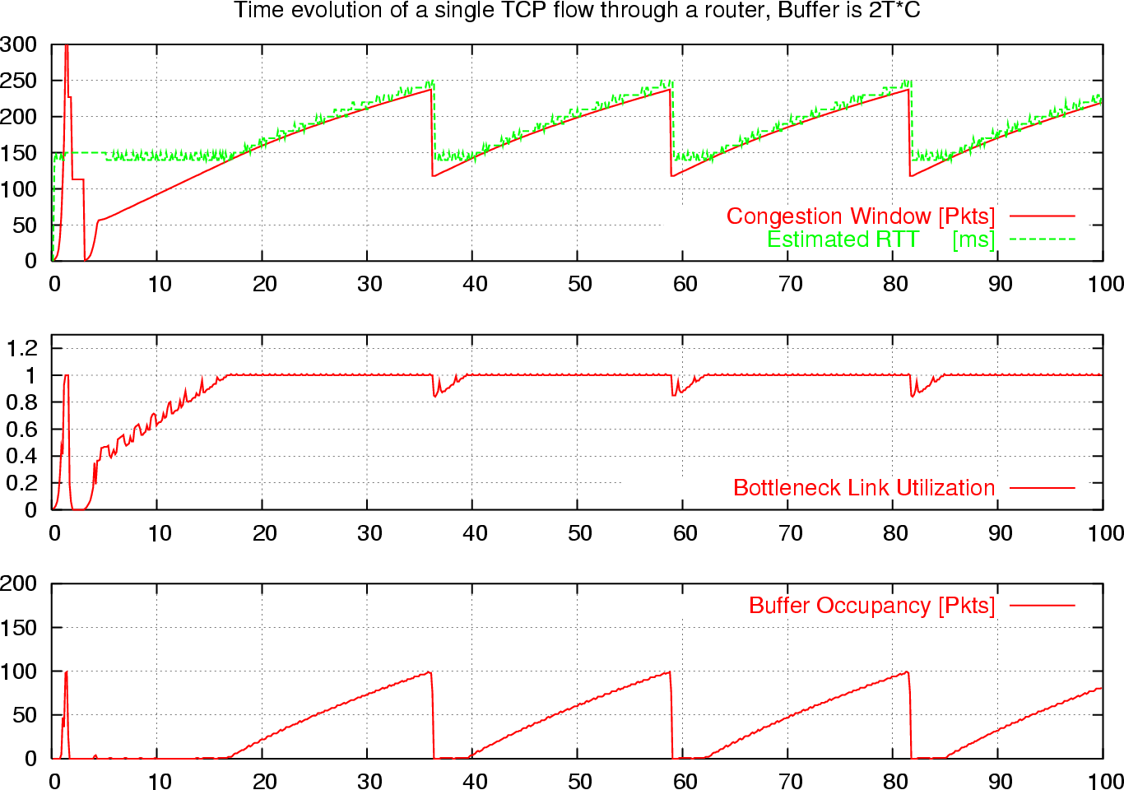
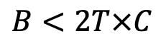
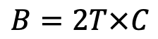
Time Evolution of a Single TCP Flow
B
A
C
B
2T
$$B=2T×C$$
$$B<2T×C$$
Notes:
This is what we see if we simulate, emulate or measure the time evolution of a single TCP flow. These graphs are from Mininet.
On the left, we have exactly 1 BDP of buffering. The Buffer occupancy.- the red line in the middle – exactly tracks the Congestion Window. And so the ratio of the two, which is the utilization of the bottleneck link stays contant all the time.
If we make the buffer smaller than the BDP, the buffer goes empty once per sawtooth. And hence W/RTT can fall below C and the bottleneck link goes unnecessarily idle.

Slide 25
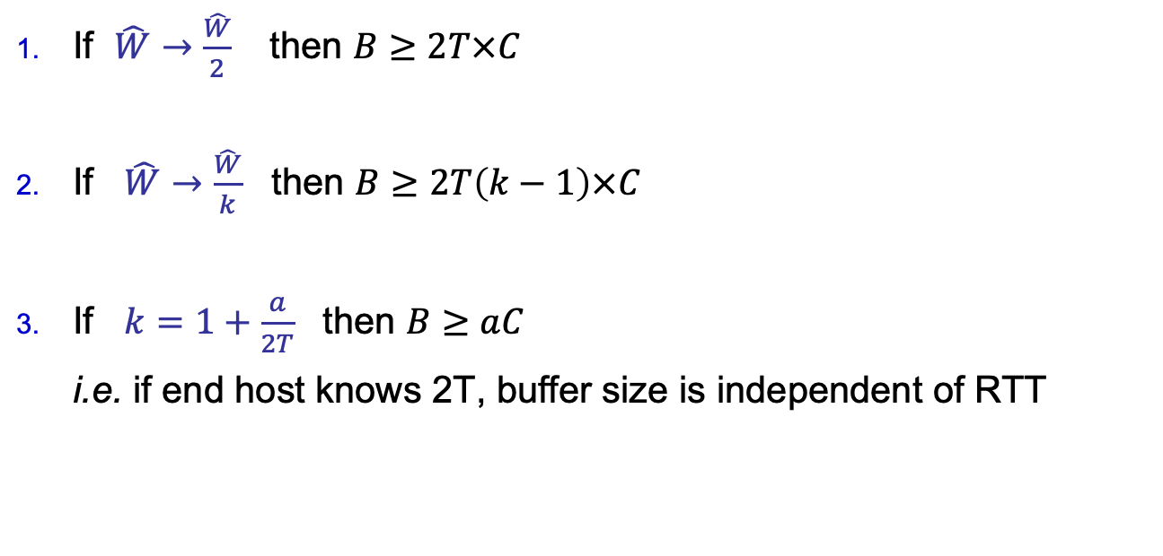
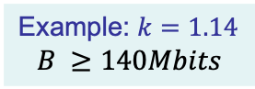
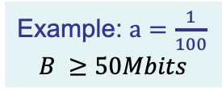
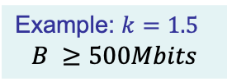
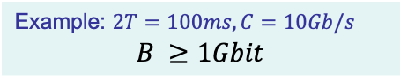
Single TCP New Reno flow: 100% Throughput
If $\hat{W}→\frac{\hat{W}}{2}$ then $B≥2T×C$
If $\hat{W}→\frac{\hat{W}}{k}$ then $B≥2T\left(k−1\right)×C$
If $k=1+\frac{a}{2T}$ then $B≥aC$ i.e. if end host knows 2T, buffer size is independent of RTT
Example: $2T=100ms, C=10Gb/s$ $$B ≥1Gbit$$
Example: $k=1.5$ $$B ≥500Mbits$$
Example: $k=1.14$ $$B ≥140Mbits$$
Example: $a=\frac{1}{100}$ $$B ≥50Mbits$$
Notes:
Notice that the buffer size equation is a direct consequence of how TCP works. In particular, because the window sized is halved each time there is a drop.
In the standard case, where cwnd is halved, it can lead to large buffers for a single flow. For example, if the minimum RTT is 100ms, a 10Gb/s link needs a 1Gbit (or 125Mbyte) buffer right before it.
It’s worth asking how big the buffer would need to be if TCPdivided cwnd by a different factor, instead of two.
It’s easy to deduce that if TCP divided cwnd by k on a drop, then we need this sized buffer. For example, if TCP divided cwnd by 1.5 instead of 2, the buffer size can be halved, while still maintaining 100% utilization of the bottleneck link.
The original Raj Jain paper had proposed dividing by 1.14, which means the buffer could be reduced by another factor of 3 to just 140Mbits, or less than 20Mbytes.
Finally, it’s worth wondering why the buffer size has a factor of RTT in it at all. Why does the buffer size depend on RTT? If the end host measures and knows the min RTT, it can pick k = 1 + a/minRTT, which means the buffer size now only depends on C. For example, if we pick a = 0.01, then the buffer size could be reduced to 50Mbits or about 6 Mbytes.

Slide 26
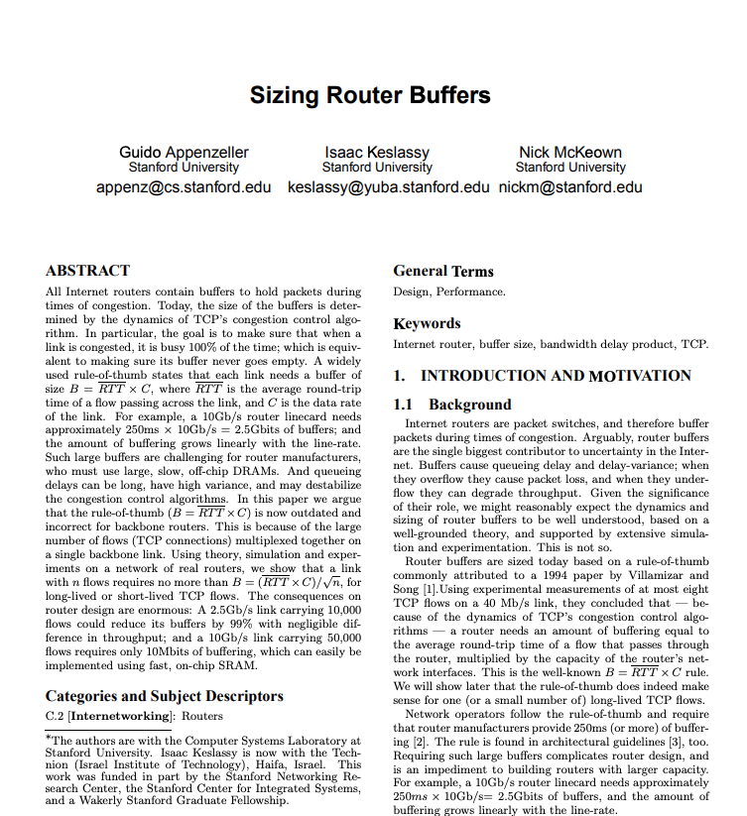
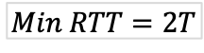
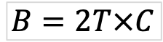
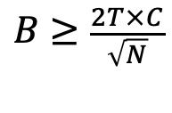
1988
1994
2004
2020
Congestion Avoidance
and Control
VJ & MK
High Performance
TCP in ANSNET
CV & CS
Sizing Router
Buffers
GA, IK, NM
$$B≥\frac{2T×C}{\sqrt{N}}$$
where N is the number of long-lived flows
$$B=2T×C$$
B
A
C
B
$$Min RTT=2T$$
Notes:
The last results hold for a single flow. But real networks carry lots of flows, particularly big backbone networks and data-center networks.
When Guido Appenzeller was doing his PhD in 2004 we were wondering how big a buffer we need if a network is carrying lots of TCP flows. This led to the result that if the TCP flows are long-lived and not synchronized with each other, the buffer size can be reduced by the square root of N, where N is the number of long-lived flows.

Slide 27
Synchronized Flows
t
Aggregate window has same dynamics
Therefore buffer occupancy has same dynamics
Rule-of-thumb still holds.

Slide 28
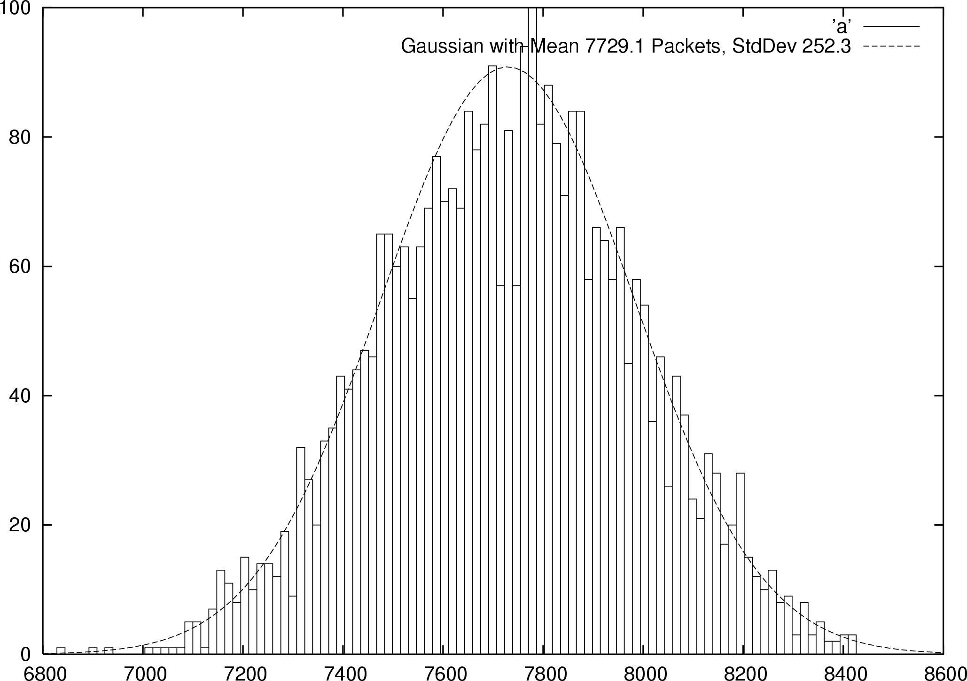
Many TCP Flows
B
0
~ Buffer Size
Probability
Distribution
Notes:
The rule of thumb for buffer sizing is based on a single TCP flow.
In the core of the Internet we have thousands of flows going though each link.
The buffer size we need here is inversely proportional to the variance of sum of these flows.
Since these flows are independent of each other, their sum has a Gaussian distribution, and the variance is decreased by the number of flows.

Slide 29
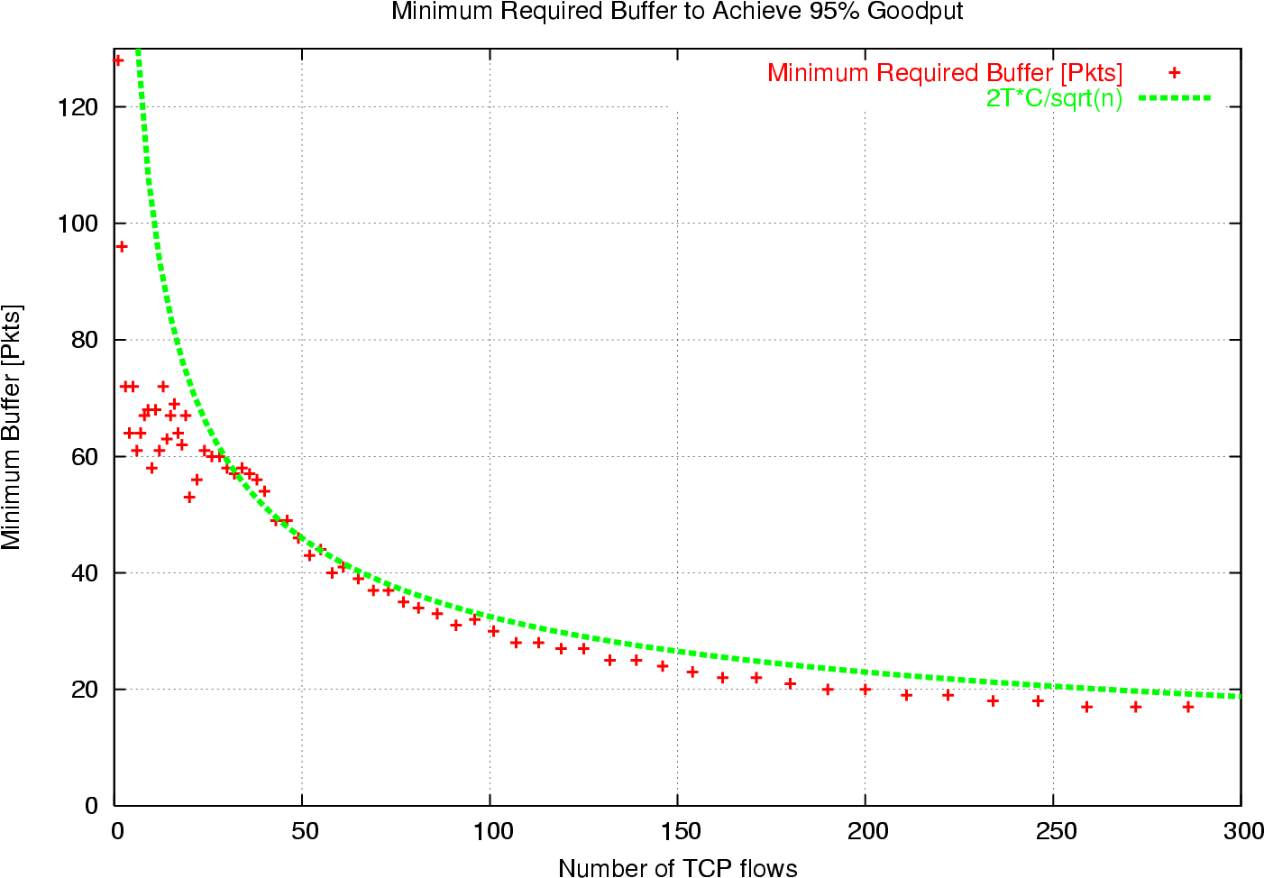

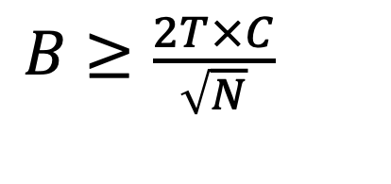
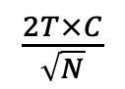
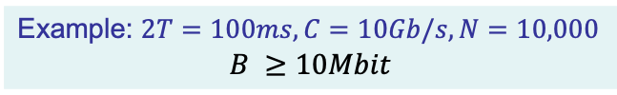
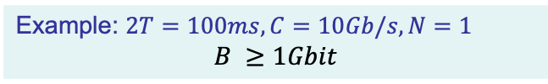
Many AIMD flows: 100% Throughput
Example: $2T=100ms, C=10Gb/s, N=1$ $$B ≥1Gbit$$
$$B≥\frac{2T×C}{\sqrt{N}}$$
Example: $2T=100ms, C=10Gb/s, N=10,000$ $$B ≥10Mbit$$
$$\frac{2T×C}{\sqrt{N}}$$
Q: Do you think $B∝\frac{1}{\sqrt{N}}$ will hold for other
congestion control algorithms…?
Notes:
For example, with our example from before, if the same network carried 10,000 flows, the buffer requirements drops by a factor of 100, from 1Gbit to 10Mbits.
The graph plots the measured buffer size as a function of N, showing it follows the 1/ sqrt(N) curve quite closely.
We would love to know if this concentrating effect holds for other congestion control schemes, such as Vegas, DCTCP, BBR and others?

Slide 30
You said
Nikhil Athreya
I think the assumptions made in the original paper are beginning to change. While they acknowledge that their work is mostly based off of TCP, they argue that single-packet sources (e.g. DNS) and constant-rate UDP sources (e.g. online games) can be modeled with short flows. However, a quick Google search tells me that (https://www.caida.org/research/traffic-analysis/tcpudpratio/) that the amount of UDP flows either has surpassed TCP flows or is at least comparable to it. I’m unsure how this would affect the results in this paper; perhaps because the results for short flows shows that average queue length is only dependent on link load and flow length, this shouldn’t be a problem, but I’d be interested to hear more about it.

Slide 31
You said
Kevin Baichoo
It seems like from the backbone router vendor’s will disavow this smaller buffer sizes, as otherwise they can’t justify the prices for their equipment.
Esther Goldstein
Do buffer sizes today go by the rule-of-thumb equation, or has the equation been refined in a different way than what was proposed in the paper?
Isabel Victoria Papadimitriou
It seems that this is working under an assumption that TCP is TCP, and router manufacturers have to deal with that regarding buffer size. Why isn’t it the other way around (“this is the buffer size, make congestion control work”), or is it possible to think about some sort of joint optimization of buffer size and paradigm?

Slide 32
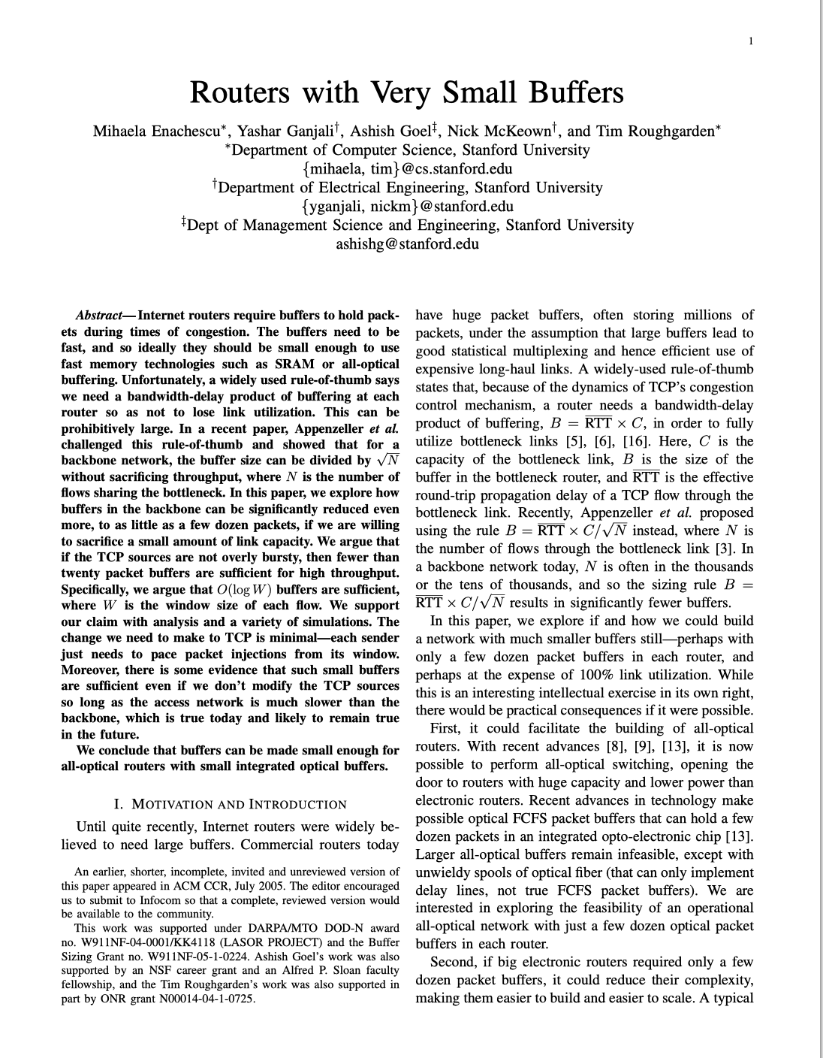

1988
1994
2004
2006
2020
Congestion Avoidance
and Control
VJ & MK
High Performance
TCP in ANSNET
CV & CS
Sizing Router
Buffers
GA, IK, NM
Routers with
Very Small Buffers
ME, YG, AG, NM, TR
$$B= O(logW)$$
1. Paced Traffic
2. Link utilization < 80%
Assumptions
$$B=2T×C$$
Only 20-50 packet buffers.
Consequences
B
A
C
B
$$Min RTT=2T$$

Slide 33

1988
1994
2004
2006
2008
2020
Congestion Avoidance
and Control
VJ & MK
High Performance
TCP in ANSNET
CV & CS
Sizing Router
Buffers
GA, IK, NM
Routers with
Very Small Buffers
ME, YG, AG, NM, TR
Experimental Study of
Router Buffers
NB, YG, MG, NM, GS
$$B=2T×C$$
B
A
C
B
$$Min RTT=2T$$

Slide 34
Buffer Sizing Experiments
Small Buffers
Stanford University dorm network
University of Wisconsin
Internet2
Level 3 Communications
Tiny Buffers
Internet2
Sprint Advanced Technology Lab
University of Toronto

Slide 35
Level 3 Communications Experiments
High link utilization
Long duration (about two weeks)
Buffer sizes 190ms (250K packets), 10ms (10K packets), 2.5ms (2500 packets), 1ms (1000 packets)
Load balancing over 3 links (2.5 Gb/s each)

Slide 36
Drop vs. Load, Buffer = 190ms, 10ms
Max Util = 96%

Slide 37
Drop vs. Load, Buffer = 1ms

Slide 38

Internet2 Experiments
Neda Beheshti
2010

Slide 39


Summary of throughput and buffer size
$$B≥2T×C$$
100%
~ 90%
Throughput
50-100 pkts
$$\frac{2T×C}{\sqrt{N}}$$
Buffer Size

Slide 40
End.

